Slide 1
Optimizing a Battery Energy Storage System for Improved Energy Market Participation
Brendan Schutte

Slide 2
Contents
Background
Motivation
Terminology
Problem and Data
Modeling
Results
Conclusion

Slide 3
Background
Graduate Student at UNO and Supply Chain Analyst for Frito Lay
Collaboration between UNO Math Department and OPPD
Energy Market Study and Battery Energy Storage System (BESS) Modeling effort

Slide 4





Motivation
Energy market is highly volatile
Changing energy portfolio
Push into renewable sources
Interest in batteries on the rise
Uncaptured value in ancillary services
Data has evolved
Evaluate traditional hourly planning window vs shorter planning window
Likely some uncaptured earnings

Slide 5

Questions...
How does a battery asset interact in the Southwest Power Pool (SPP) integrated marketplace?
How do different dispatch windows impact revenue and ultimately asset evaluation?

Slide 6
Terminology
Real Time Locational Marginal Pricing (RTLMP): price to buy energy from the market at a specific node location. Price fluctuates based on supply/availability, congestion, transmission loss, etc.
Load: The amount of electric power delivered or required at any specific point or points on a system. The requirement originates at the consumers’ Energy-consuming equipment
Frequency: Cycles per second in electric current. Energy grids need to maintain a consistent frequency (60 hertz). The more demand in the system, the more the load the system has to support, frequency goes down (and vice versa)

Slide 7
Terminology
Duration (of a battery): the amount of time needed for a battery asset to discharge fully from max capacity
Round trip efficiency: percentage of energy put into storage that is later retrieved, as some energy is consumed when added to a battery
Conversion loss (inverter losses, electric potential to chemical)
Ohmic loss (resistance)
Throughput Efficiency: for this model, represents the call/dispatch percentage of a particular market product, meaning the proportion of time the asset will actually dispatch during a particular interval
Dispatch window: the interval of time used to generate a schedule. An hourly window plans battery operations for each hour, a 5-minute window plans for each 5-minute interval in a day

Slide 8
Terminology
Ancillary Service: Generally, refers to the services necessary to support the transmission of capacity and energy from generation sources to loads while maintaining reliable operation of the transmission system
Spinning Reserve - The unloaded generation that is synchronized to the system and ready to serve additional demand. (10 minutes or less)
Supplemental Reserve - Generation not connected to the system but capable of serving demand within a specified time or interruptible load that can be removed from the system in a specified time (30 mins or less)
Regulation Up - The process of increasing electricity generation or decreasing consumption in response to high energy demand or sudden drop in frequency (5 minutes or less). Also referred to as Frequency Regulation
Regulation down - The process of decreasing electricity generation or increasing consumption in response to lower energy demand or sudden increase in frequency (5 minutes or less). Also referred to as Frequency Response
Day Ahead Market: The financially binding market for Energy and Operating Reserve that is conducted on the day prior to the Operating Day

Slide 9
Problem Statement
Statement: Given real time and day ahead market prices for a given regional power pool for each 5-minute interval, what is the optimal battery dispatch schedule? Using the same data, compare to a schedule that plans at the hourly window instead. Identify differences in behavior, earnings, and mileage.
Data: Market prices in 5-minute intervals from 2021 and 2022 for the following products (real time and day ahead equivalents). Data is sourced from SPP energy market data.
RTLMP (charge and discharge)
Regulation Up
Regulation Down
Spinning Reserve
Supplemental Reserve
“Idling”
Hourly pricing is calculated as the average 5-minute interval price of all intervals in the hour
Solution approach: Build a Mixed Integer Linear Program (MILP) that optimizes the dispatch schedule by maximizing earnings for a given month
Solver: Gurobi
Implementation: Python (analysis done through R)

Slide 10
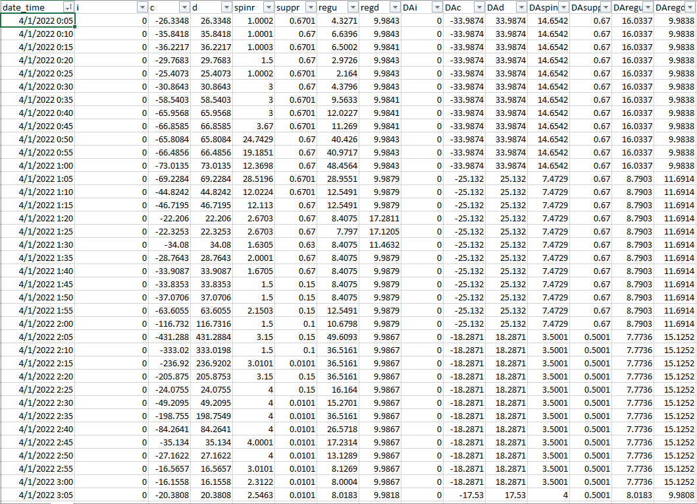

Slide 11
MILP Formulation
Linear program: class of optimization problems that seeks to maximize (or minimize) a linear objective function subject to a set of linear inequality constraints composed of continuous decision variables
In mixed integer linear programs, some decision variables are restricted to be integers
Optimal solutions are found using variations of the branch and bound algorithm

Slide 12
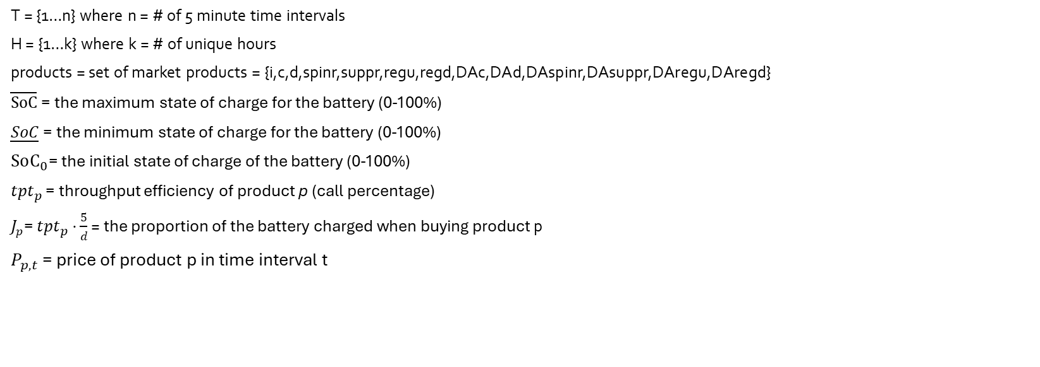
Model Definitions
T = {1…n} where n = # of 5 minute time intervals
H = {1…k} where k = # of unique hours
products = set of market products = {i,c,d,spinr,suppr,regu,regd,DAc,DAd,DAspinr,DAsuppr,DAregu,DAregd}
$\overline{SoC}$ = the maximum state of charge for the battery (0-100%)
$\underline{SoC}$ = the minimum state of charge for the battery (0-100%)
$SoC_{0}$= the initial state of charge of the battery (0-100%)
$tpt_{p}$ = throughput efficiency of product p (call percentage)
$J_{p}$= $tpt_{p}$ $⋅$ $\frac{5}{d}$ = the proportion of the battery charged when buying product p
$P_{p,t}$ = price of product p in time interval t

Slide 13
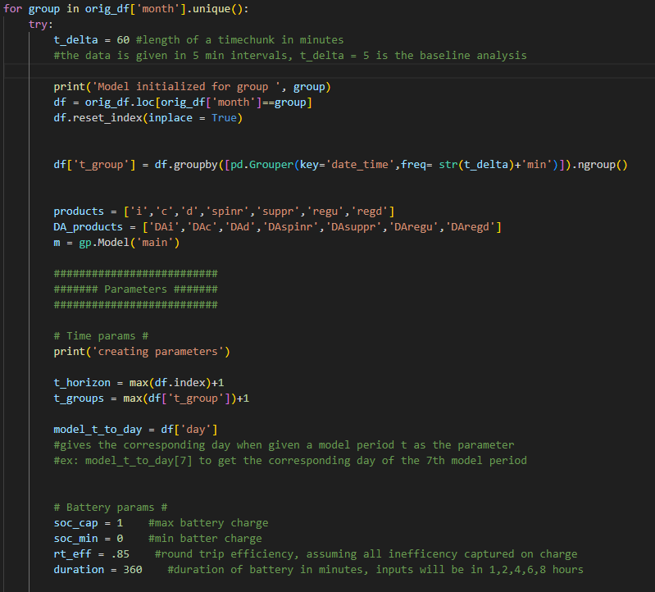

Slide 14
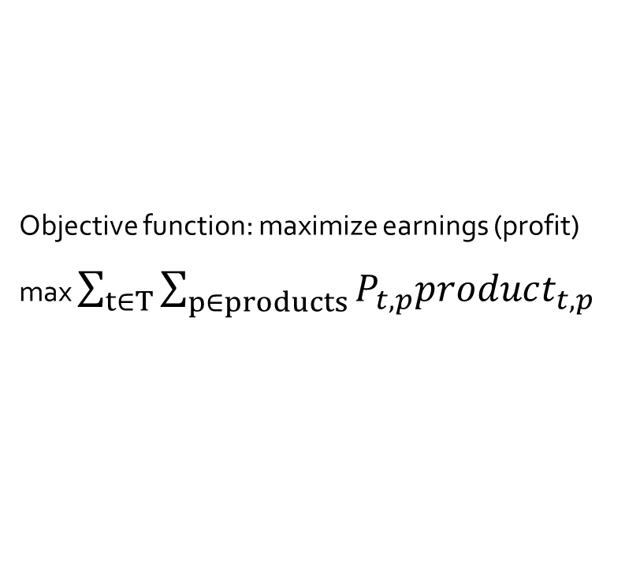
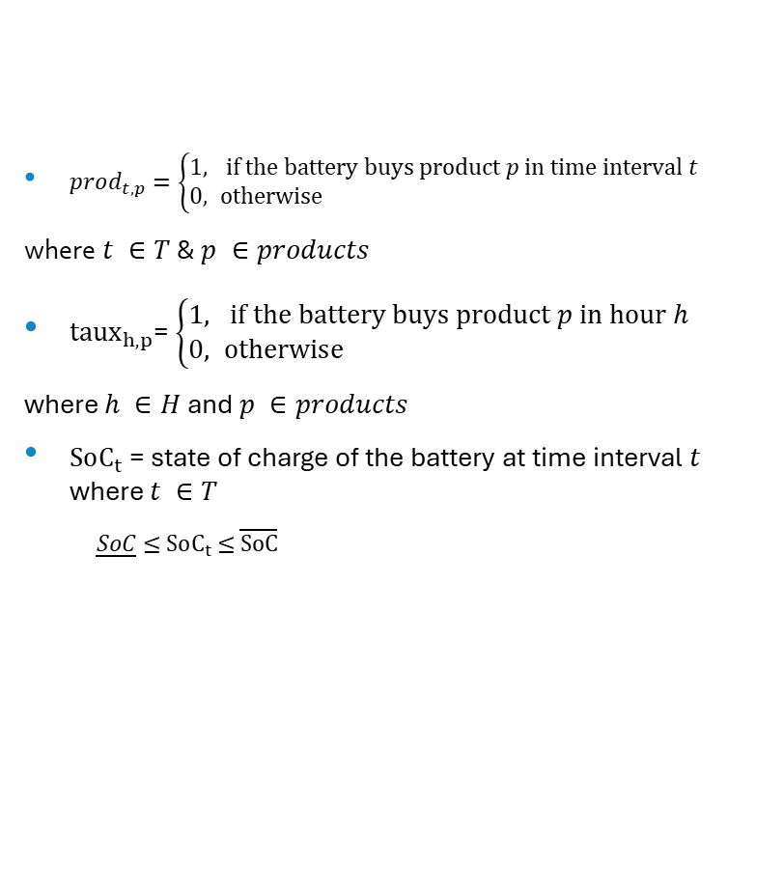
Decision variables and Objective Function
Objective function: maximize earnings (profit)
max $\sum_{t∈T}{\sum_{p∈products}{P_{t,p}product_{t,p}}}$
$prod_{t,p}=\left\{\begin{aligned}1, & \text{if} \text{the} \text{battery} \text{buys} \text{product} p \text{in} \text{time} \text{interval} t \\ 0, &\text{otherwise}\end{aligned}\right.$
where $t ∈T$ & $p ∈products$
$taux_{h,p}$= $\left\{\begin{aligned}1, & if the battery buys product p in hour h \\ 0, &\text{otherwise}\end{aligned}\right.$
where $h ∈H$ and $p ∈products$
$SoC_{t}$ = state of charge of the battery at time interval $t$ where $t ∈T$
$\underline{SoC}$ $≤$ $SoC_{t}$ $≤$ $\overline{SoC}$

Slide 15
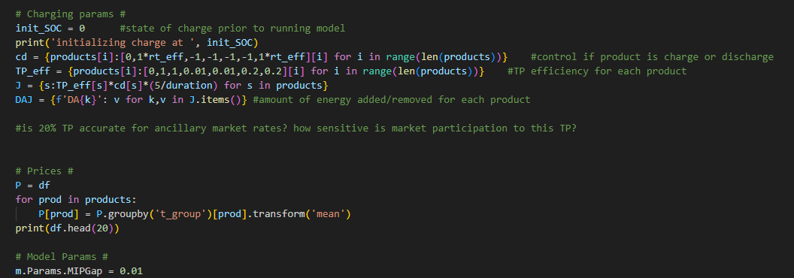
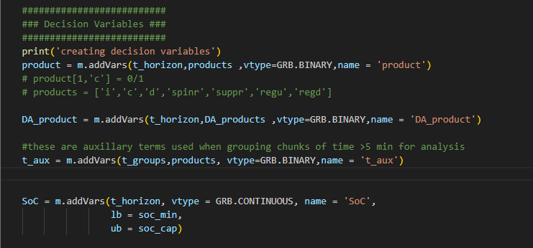
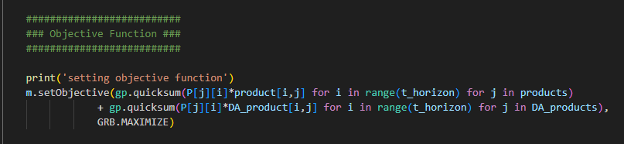

Slide 16
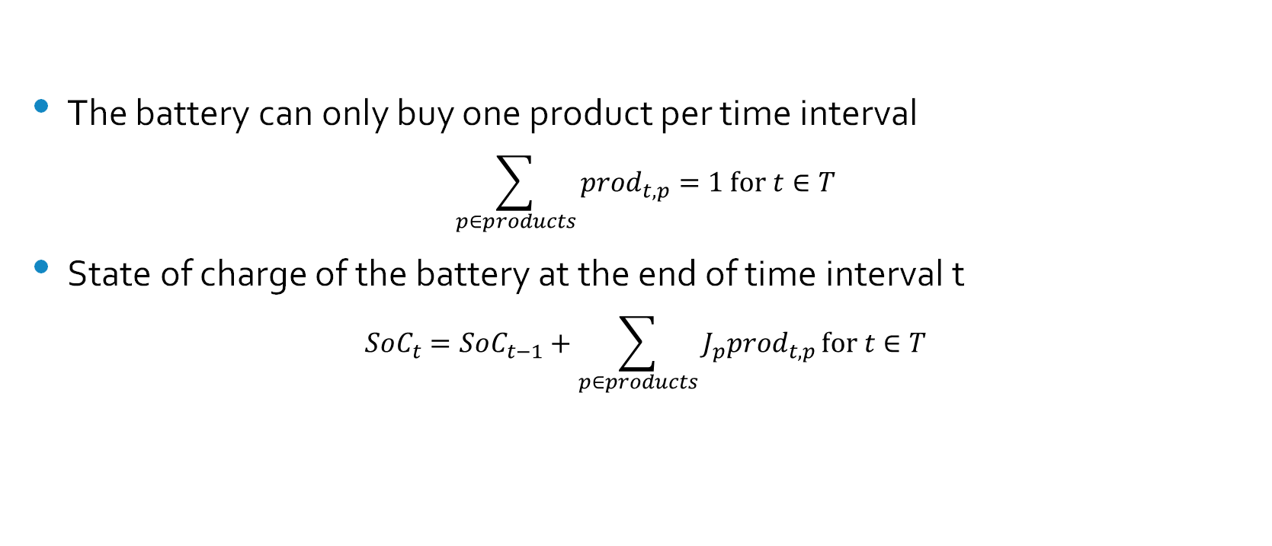
Constraints
The battery can only buy one product per time interval
$$\sum_{p∈products}{prod_{t,p}}=1 \text{for} t∈T$$
State of charge of the battery at the end of time interval t
$$SoC_{t}=SoC_{t−1}+\sum_{p∈products}{J_{p}prod_{t,p}}\text{for} t∈T$$

Slide 17
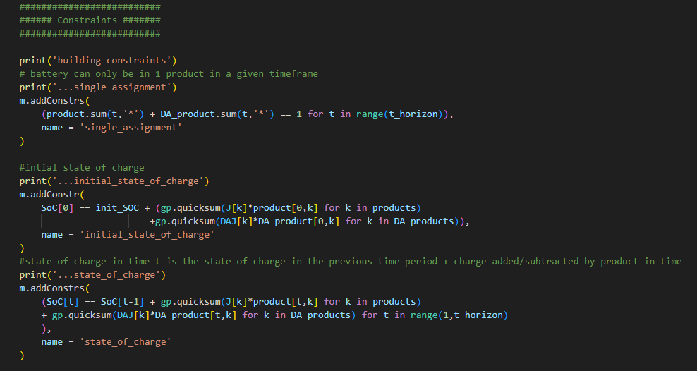

Slide 18
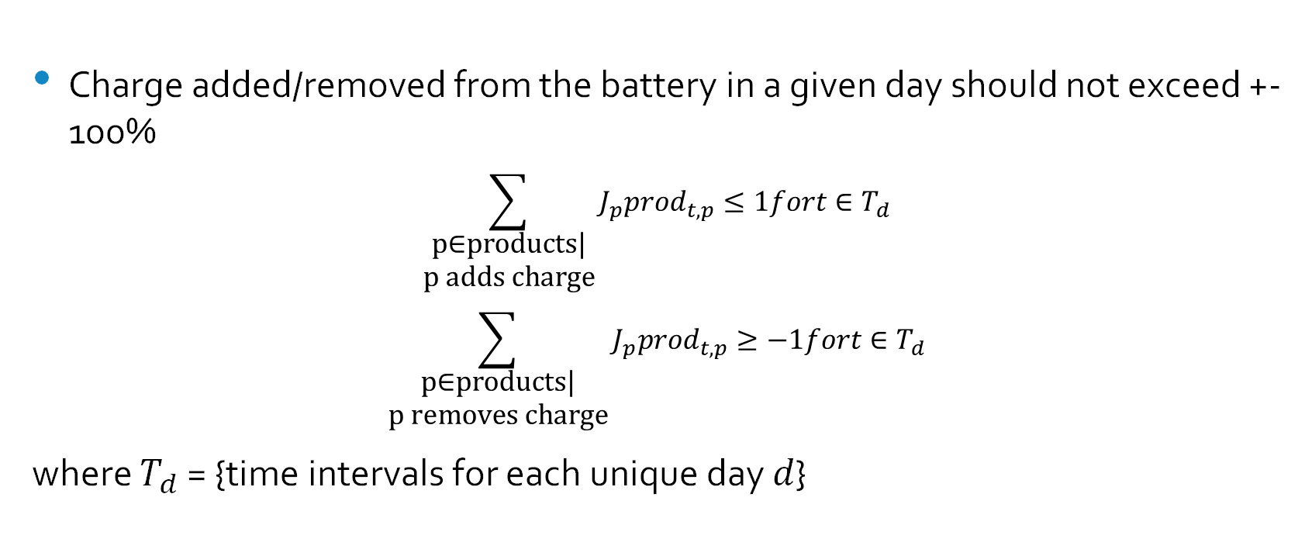
Constraints
Charge added/removed from the battery in a given day should not exceed +-100%
$$\sum_{\begin{aligned}\text{p}\text{∈}\text{products}\text{|} \\ \text{p} \text{adds} \text{charge}\end{aligned}}{J_{p}prod_{t,p}}≤1fort∈T_{d}$$
$$\sum_{\begin{aligned}\text{p}\text{∈}\text{products}\text{|} \\ \text{p} \text{removes} \text{charge}\end{aligned}}{J_{p}prod_{t,p}}≥−1fort∈T_{d}$$
where $T_{d}$ = {time intervals for each unique day $d$}

Slide 19
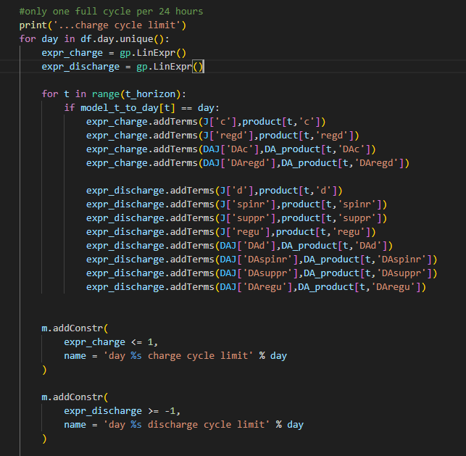

Slide 20
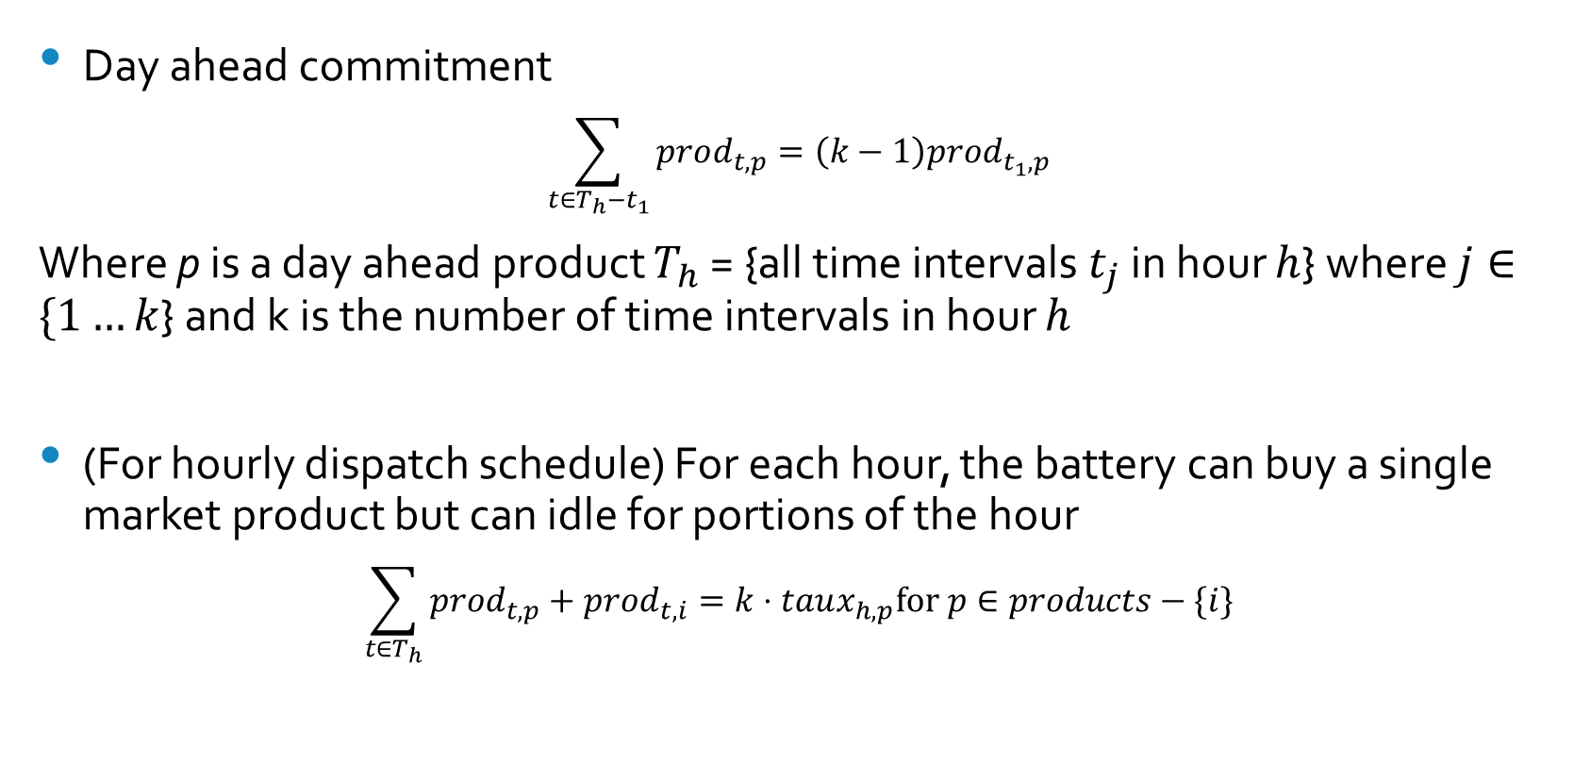
Constraints
Day ahead commitment
$$\sum_{t∈T_{h}−t_{1}}{prod_{t,p}}=\left(k−1\right)prod_{t_{1},p}$$
Where p is a day ahead product $T_{h}$ = {all time intervals $t_{j}$ in hour $h$} where $j∈\{1…k$} and k is the number of time intervals in hour $h$
(For hourly dispatch schedule) For each hour, the battery can buy a single market product but can idle for portions of the hour
$$\sum_{t∈T_{h}}{prod_{t,p}+prod_{t,i}}=k⋅taux_{h,p}\text{for} p∈products−\{i\}$$

Slide 21
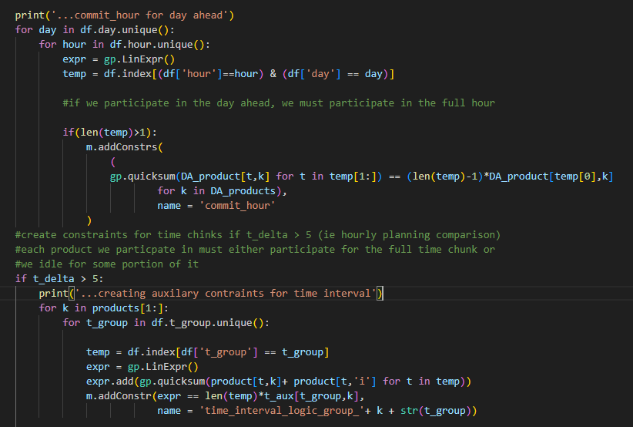

Slide 22

Key Insights
Relative earnings between planning windows
Day Ahead market participation
Behavior of the Battery Asset
Total mileage on the asset
Key Decision points

Slide 23

Earnings

Slide 24
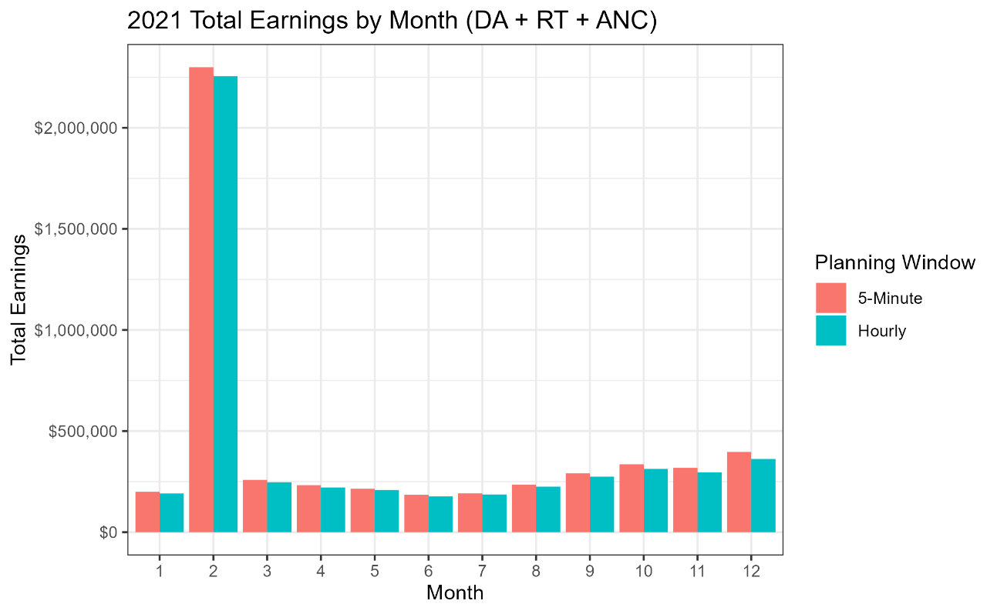
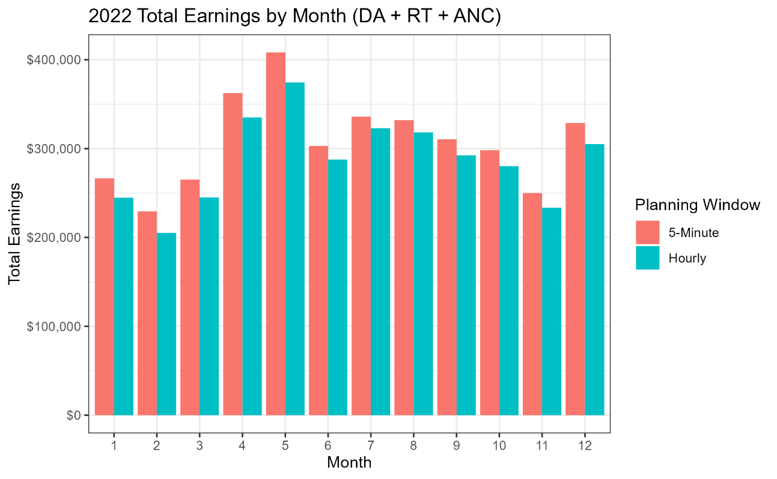

Slide 25
2021
Month | 5-min earnings | Hourly Earnings | %age increase | $$ increase
1 | $ 199,969.10 | $ 191,257.10 | 5% | $8,712.04
2 | $ 2,299,821.30 | $ 2,255,683.40 | 2% | $44,137.91
3 | $ 258,800.00 | $ 246,530.40 | 5% | $12,269.58
4 | $ 232,627.50 | $ 221,199.20 | 5% | $11,428.27
5 | $ 214,981.80 | $ 208,215.80 | 3% | $6,765.94
6 | $ 184,562.70 | $ 177,355.90 | 4% | $7,206.85
7 | $ 192,181.70 | $ 185,908.20 | 3% | $6,273.45
8 | $ 234,660.60 | $ 225,094.50 | 4% | $9,566.13
9 | $ 291,177.70 | $ 274,541.10 | 6% | $16,636.64
10 | $ 335,899.00 | $ 312,903.00 | 7% | $22,995.95
11 | $ 317,864.90 | $ 295,615.90 | 8% | $22,249.00
12 | $ 397,036.60 | $ 361,913.70 | 10% | $35,122.87
Total earnings
5-min: $ 5,159,582.90
Hourly: $ 4,956,218.20
+ $ 203,364.70 increase
Averages
Earnings increased +5.2% on average per month
$$ earned per month +$ 16,947.05 on average
2022
Month | 5-min earnings | Hourly Earnings | %age increase | $$ increase
1 | $ 266,542.60 | $ 244,711.00 | 9% | $21,831.65
2 | $ 229,252.90 | $ 205,190.70 | 12% | $24,062.26
3 | $ 265,118.90 | $ 245,033.60 | 8% | $20,085.32
4 | $ 362,606.80 | $ 335,142.50 | 8% | $27,464.28
5 | $ 408,254.20 | $ 374,440.70 | 9% | $33,813.50
6 | $ 303,006.00 | $ 287,658.90 | 5% | $15,347.06
7 | $ 336,014.70 | $ 322,947.90 | 4% | $13,066.83
8 | $ 332,052.80 | $ 318,326.10 | 4% | $13,726.78
9 | $ 310,617.20 | $ 292,480.90 | 6% | $18,136.36
10 | $ 298,224.70 | $ 280,283.60 | 6% | $17,941.12
11 | $ 250,008.60 | $ 233,536.60 | 7% | $16,471.93
12 | $ 328,768.10 | $ 305,103.50 | 8% | $23,664.62
Total earnings
5-min: $ 3,690,467.50
Hourly: $ 3,444,856.00
+ $ 245,611.50 increase
Averages
Earnings increased +7.3% on average per month
$$ earned per month +$ 20,467.64 on average

Slide 26
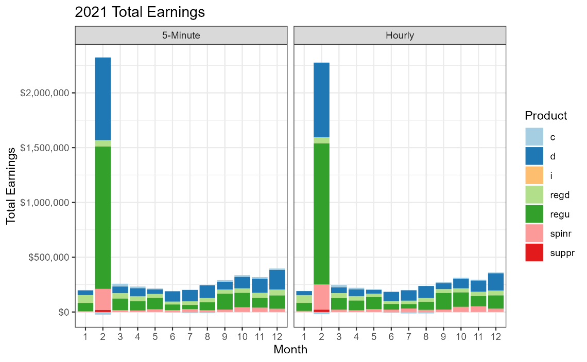
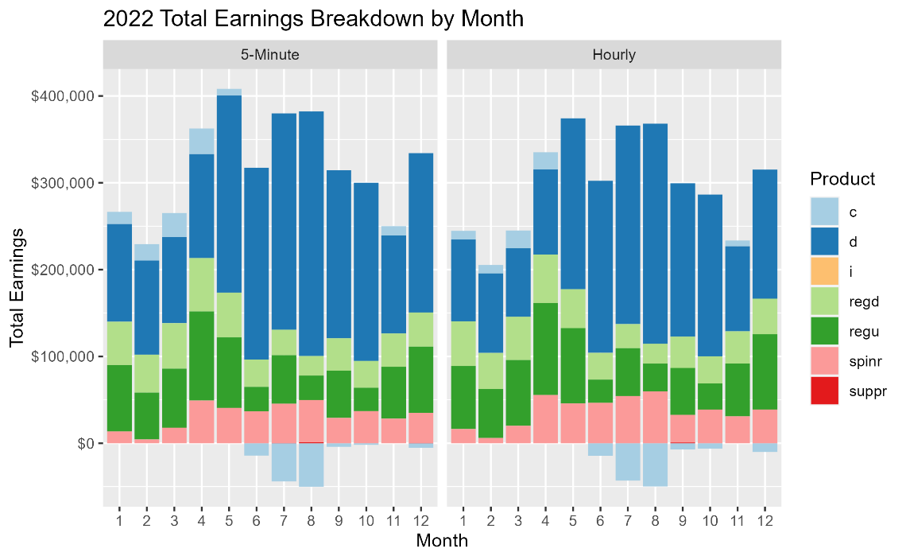

Slide 27
Day Ahead vs Real Time market participation
2021
2022
Participation
Earnings
Earnings Proportion
 | Day Ahead | Real Time
5-min | 37.6% | 62.4%
Hourly | 44.0% | 56.0%
 | -6.5% | 6.5%
Participation
Earnings
Earnings Proportion
 | Day Ahead | Real Time
5-min | 31.8% | 68.2%
Hourly | 40.6% | 59.4%
 | -8.8% | 8.8%
 | Day Ahead | Real Time
5-min | $ 2,760,856 | $ 2,398,727
Hourly | $ 2,878,410 | $ 2,077,808
 | $ (117,554) | $ 320,919
 | Day Ahead | Real Time
5-min | $ 1,340,011 | $ 2,350,457
Hourly | $ 1,401,390 | $ 2,043,466
 | $ (61,379) | $ 306,991
 | Day Ahead | Real Time
5-min | 53.5% | 46.5%
Hourly | 58.1% | 41.9%
 | Day Ahead | Real Time
5-min | 36.3% | 63.7%
Hourly | 40.7% | 59.3%
Insight: Using a 5-minute planning window will net more earnings in the real time market, but less in the day ahead market compared to an hourly window

Slide 28
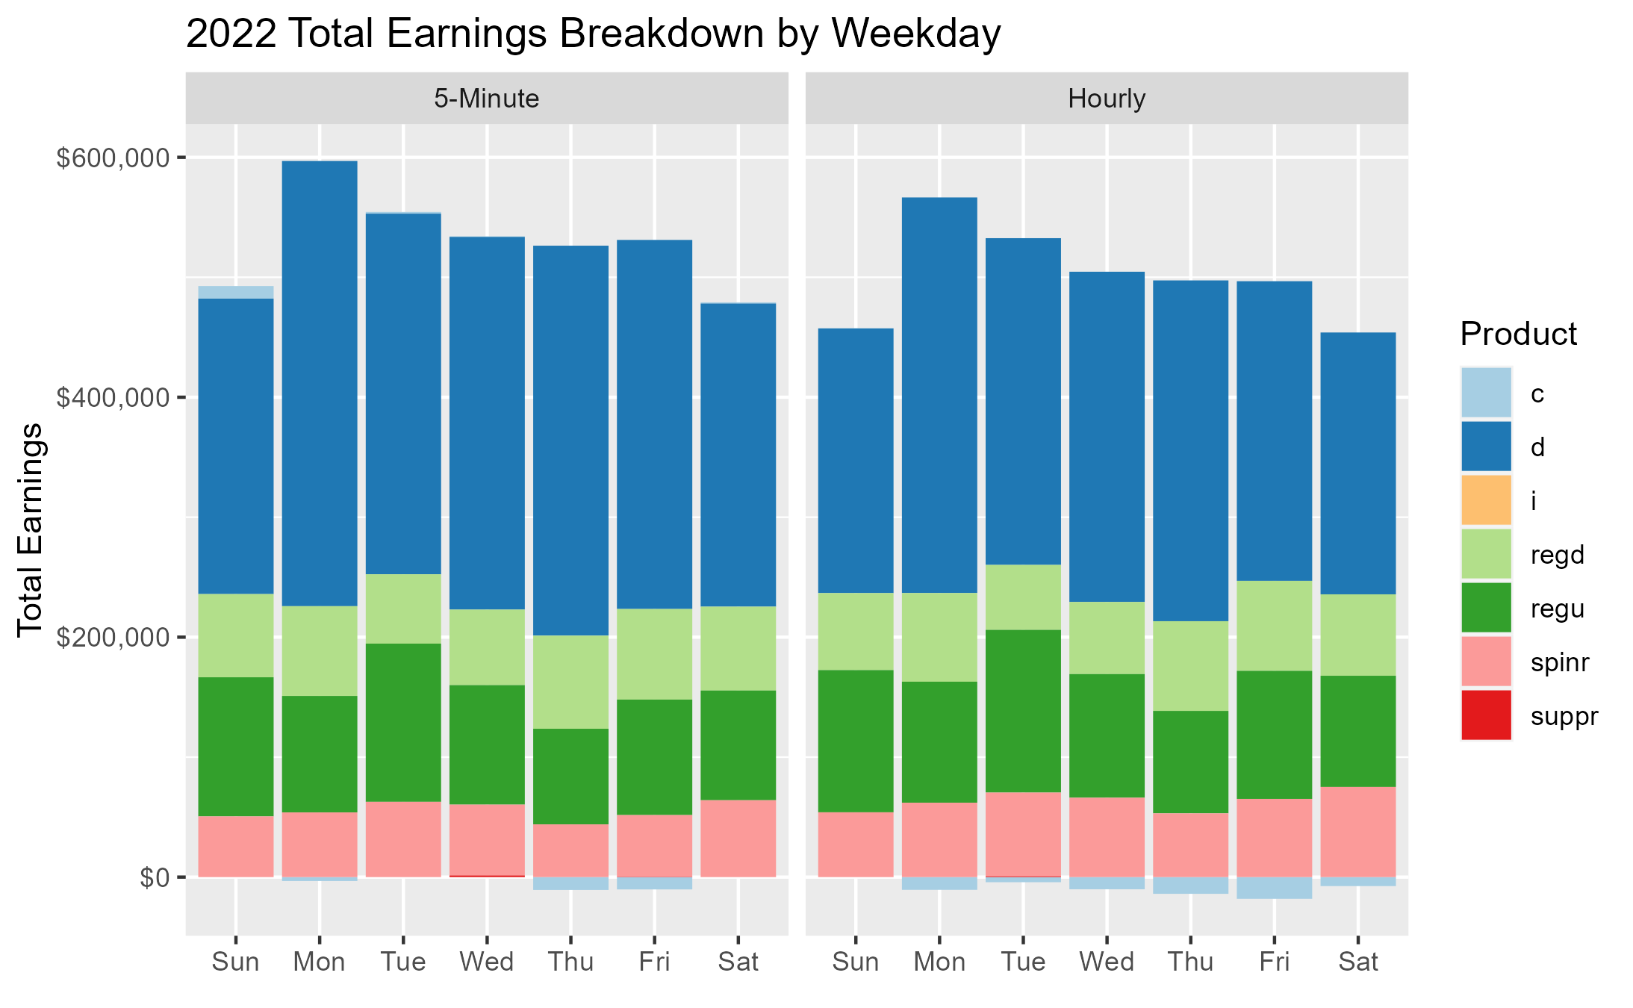
Earnings by Weekday
Summed earnings for each weekday across all weeks
Schedules are very similar.. but the 5-minute window was able to earn more on the RTLMP
Trend likely relates to the work week

Slide 29
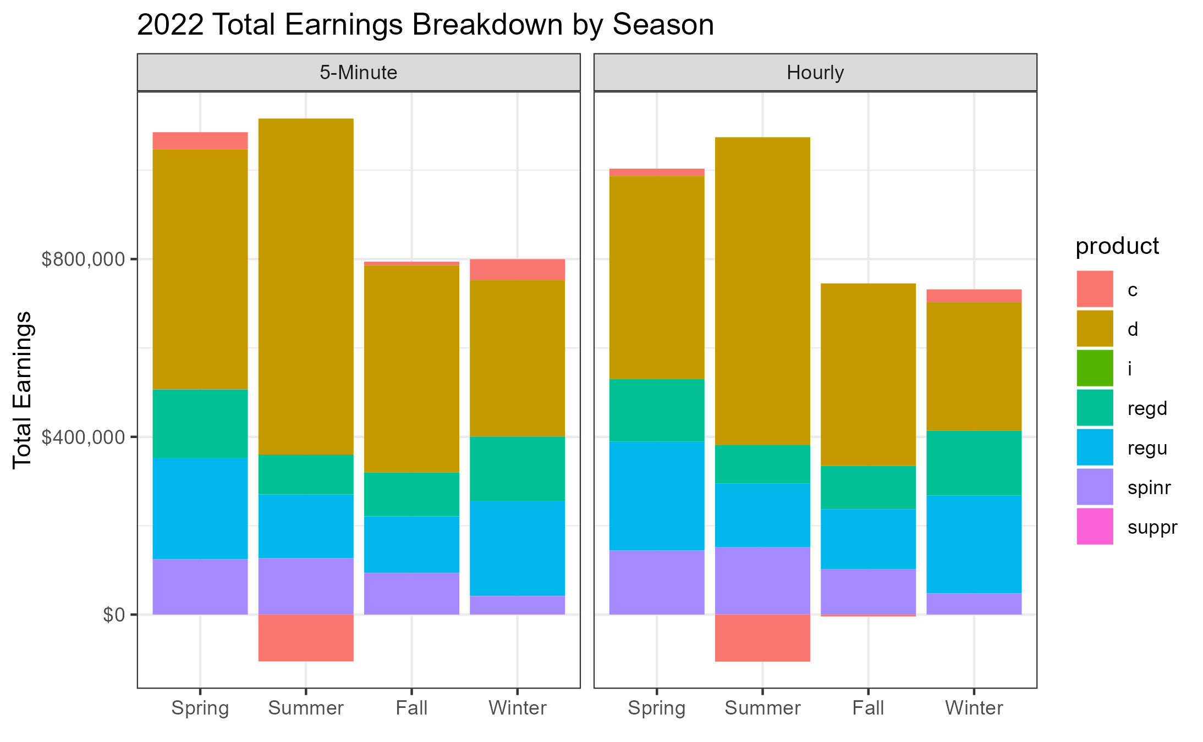
Earnings by Season
RTLMP Earnings
Spring
5-Minute | $38,736
Hourly | $16,561
Summer
5-Minute | -$105,305
Hourly | -$105,851
Fall
5-Minute | $7,932
Hourly | -$4,165
Winter
5-Minute | $47,746
Hourly | $29,203

Slide 30
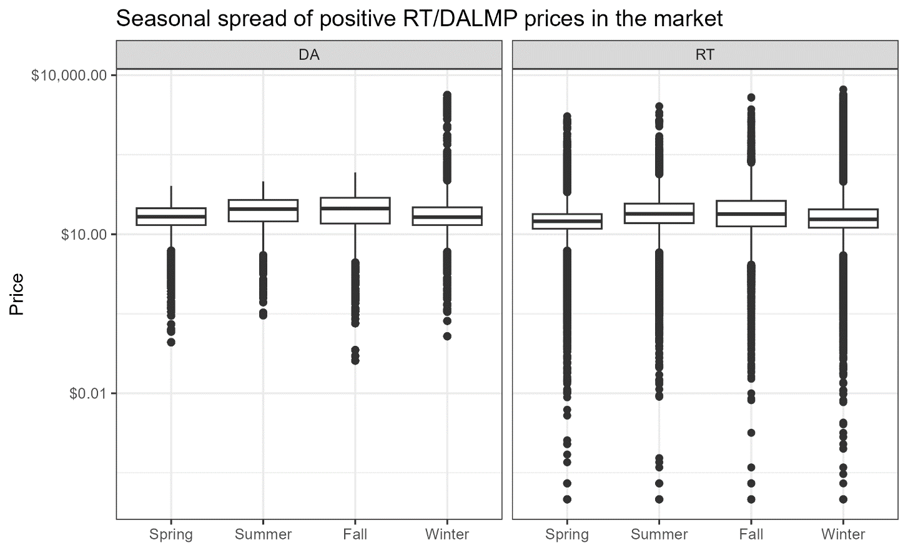
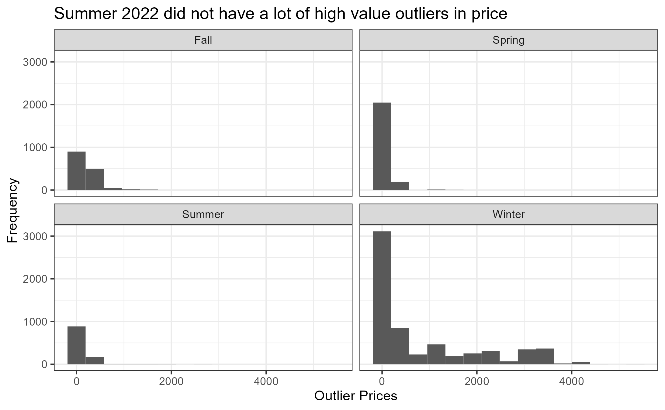
Analysis on Summer Outliers

Slide 31
State of Charge Over Time
2021

Slide 32
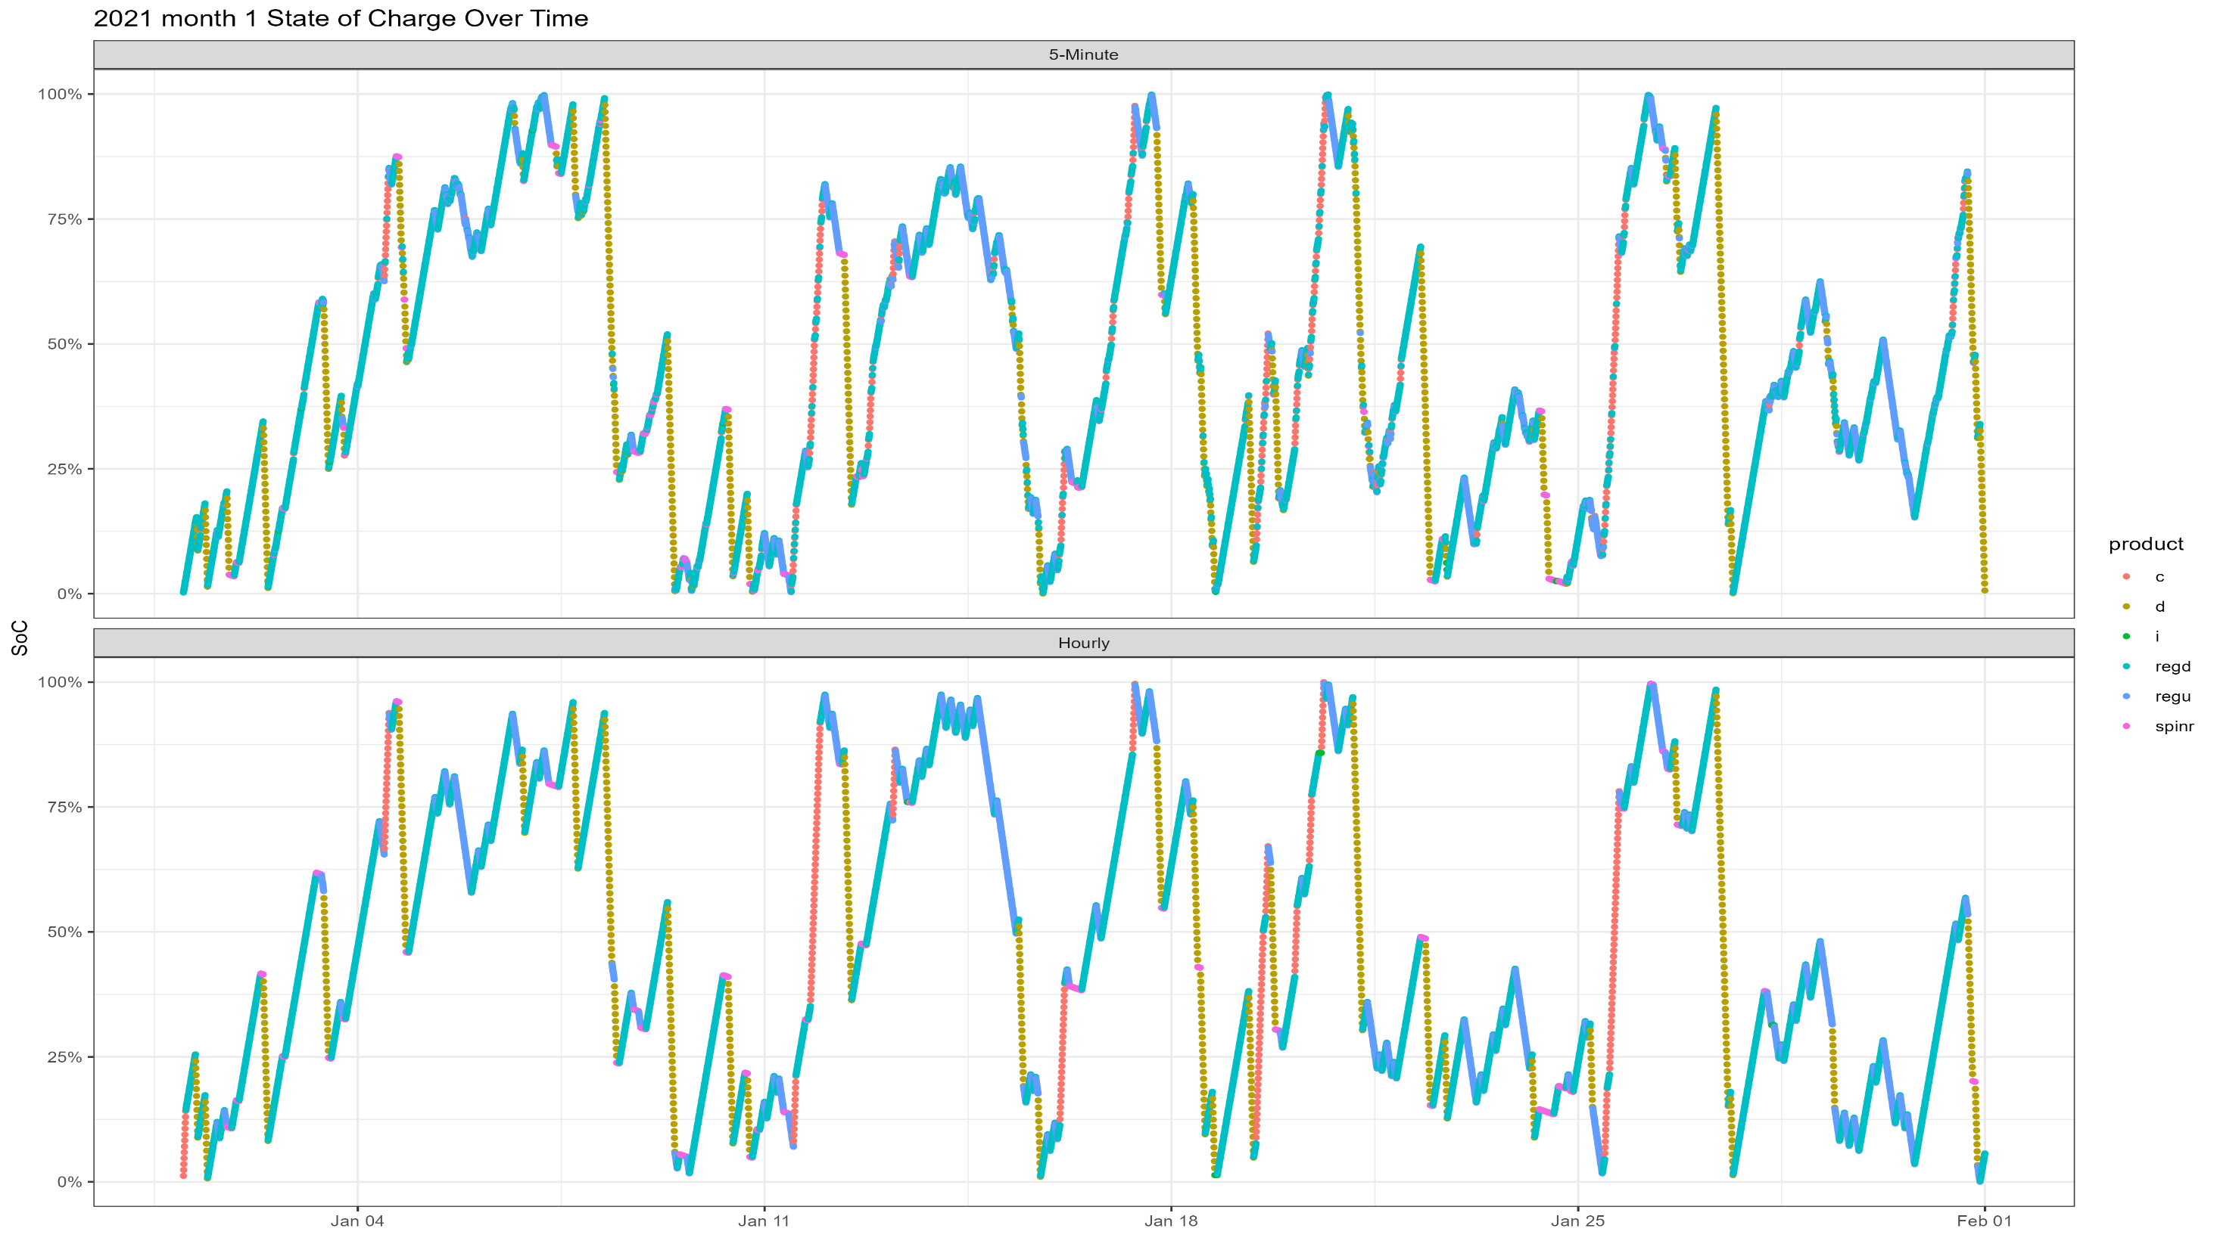

Slide 33
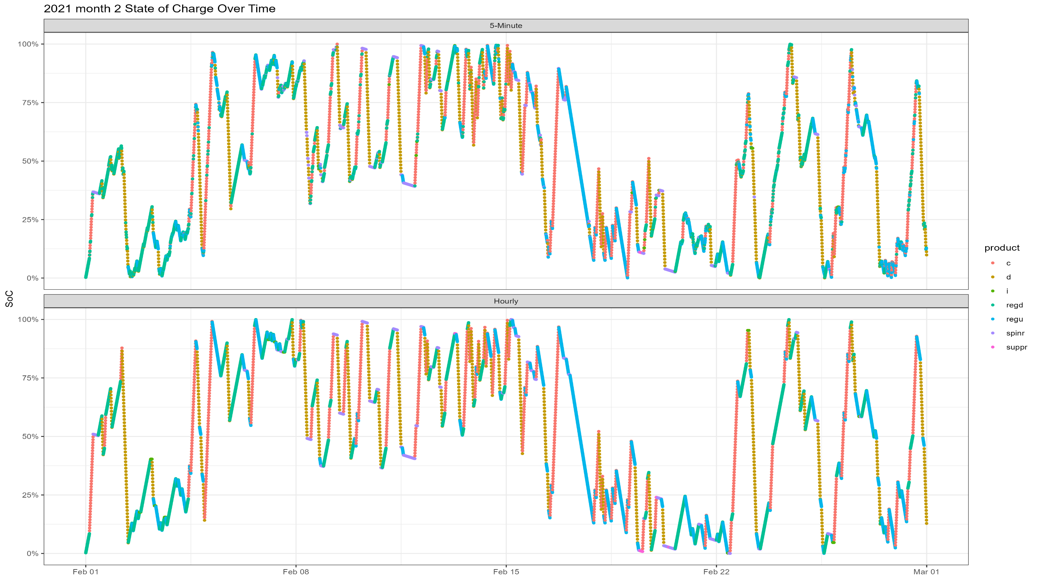

Slide 34
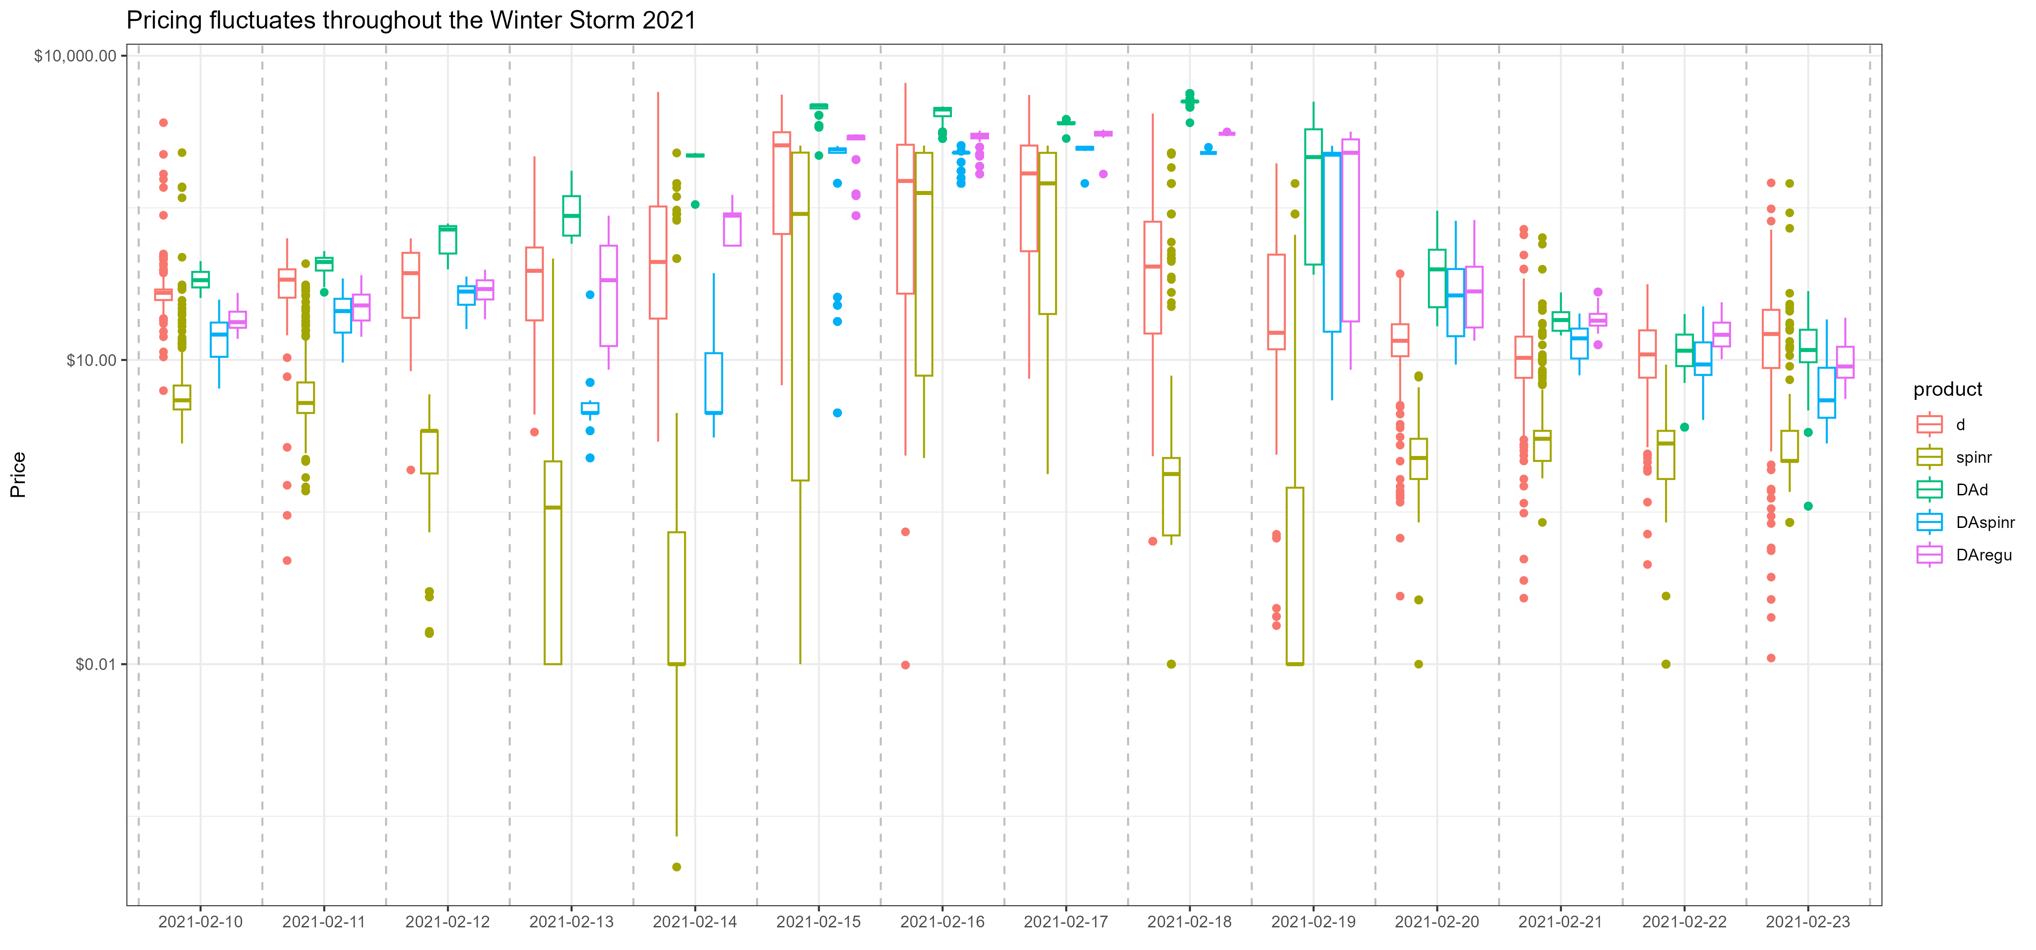

Slide 35
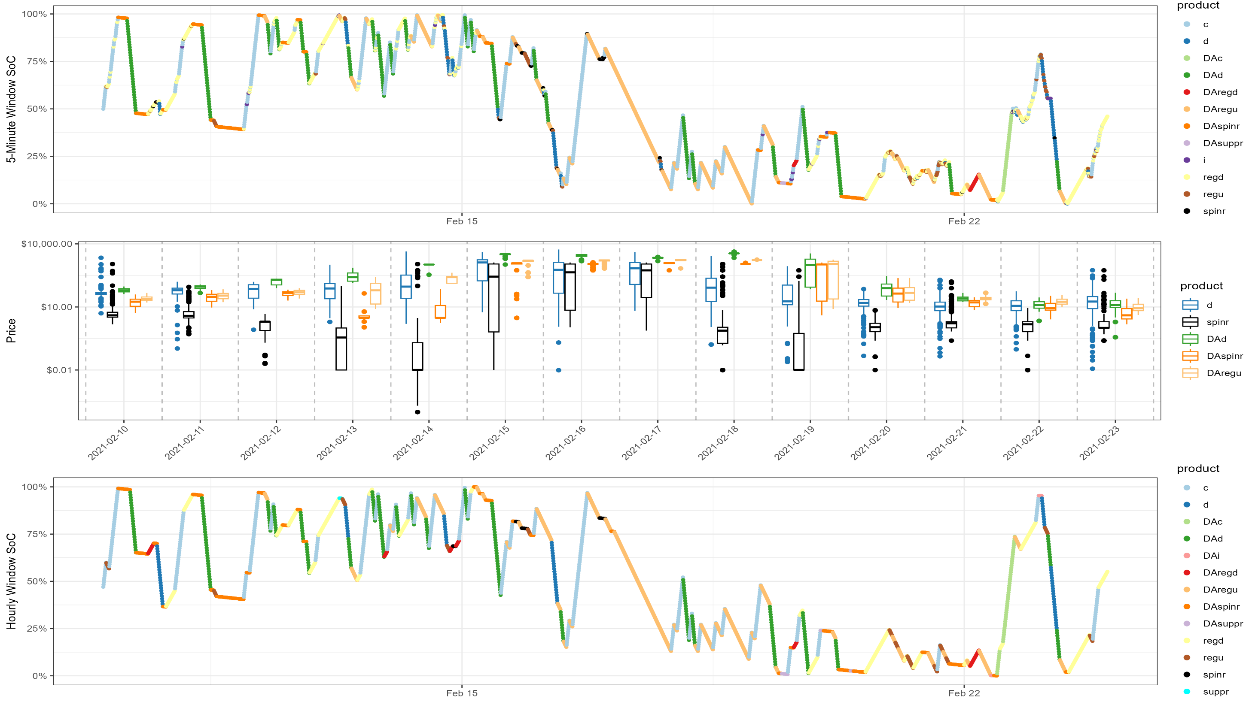

Slide 36
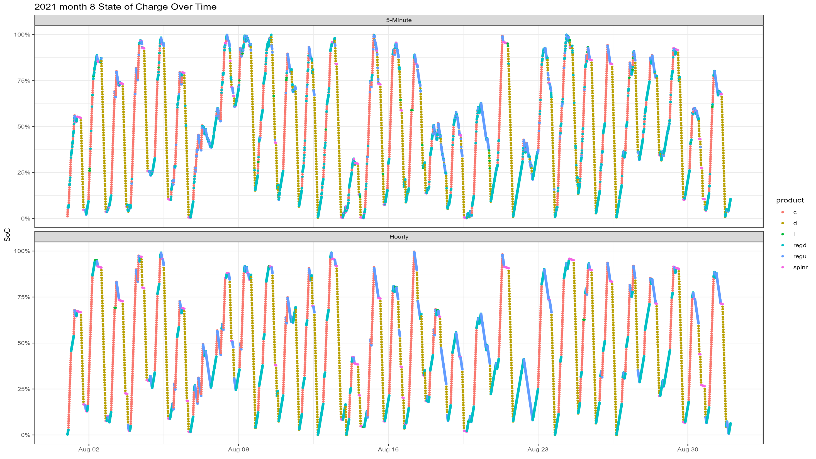

Slide 37



Slide 38
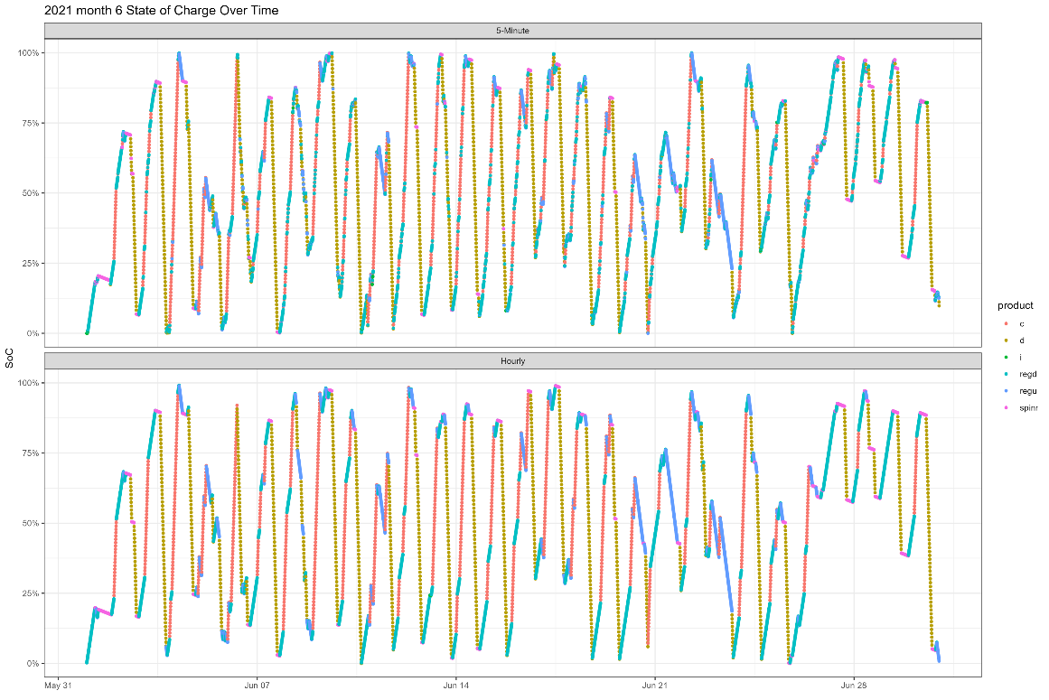
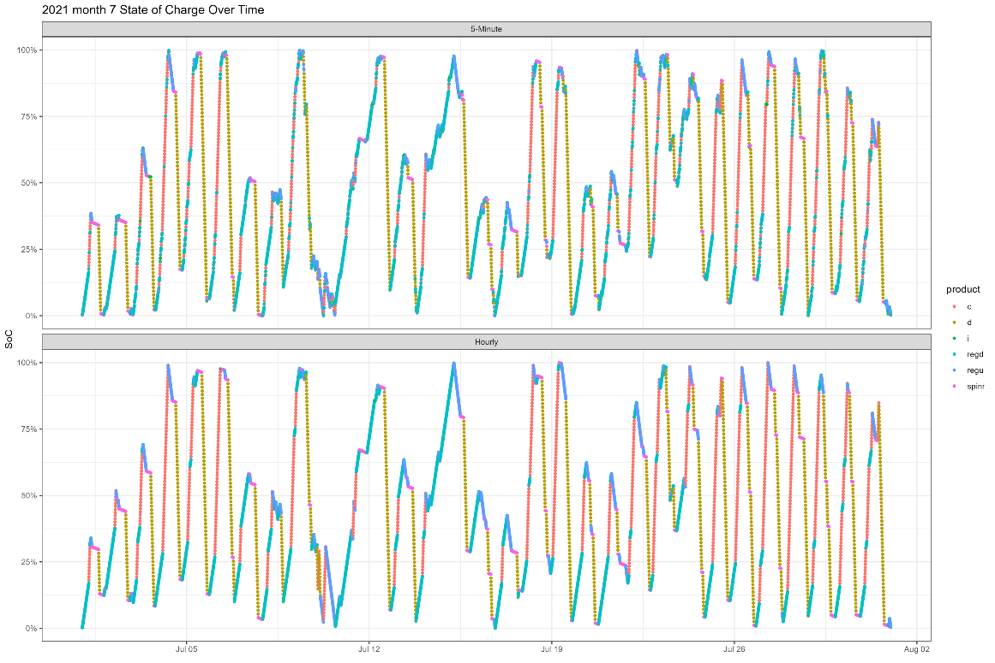
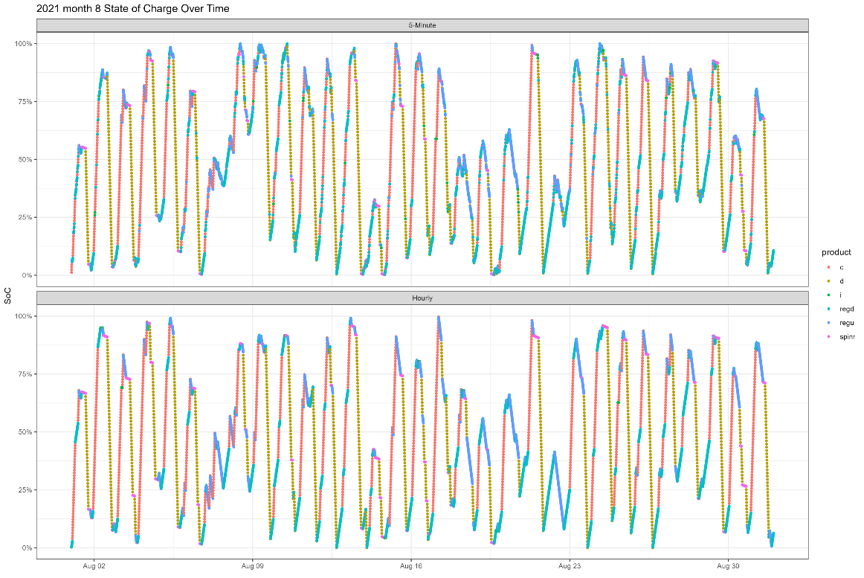
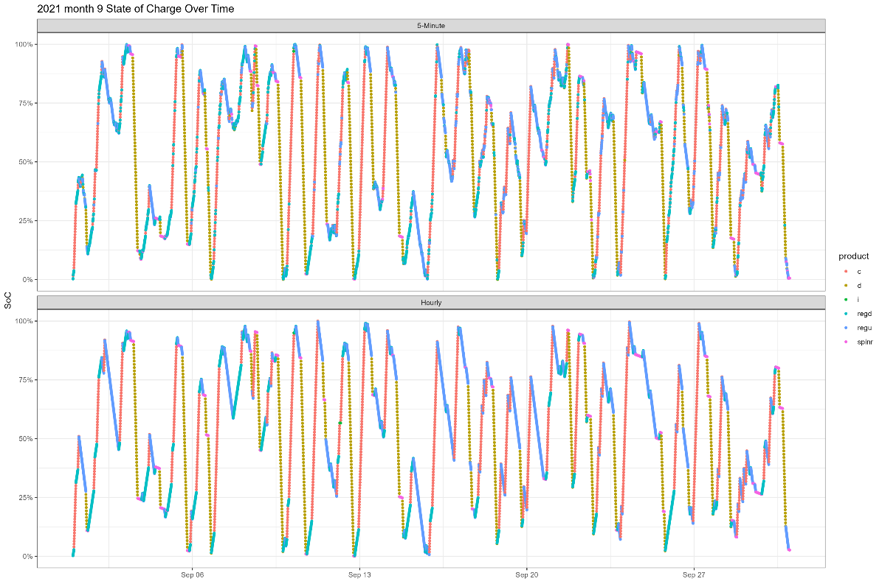

Slide 39
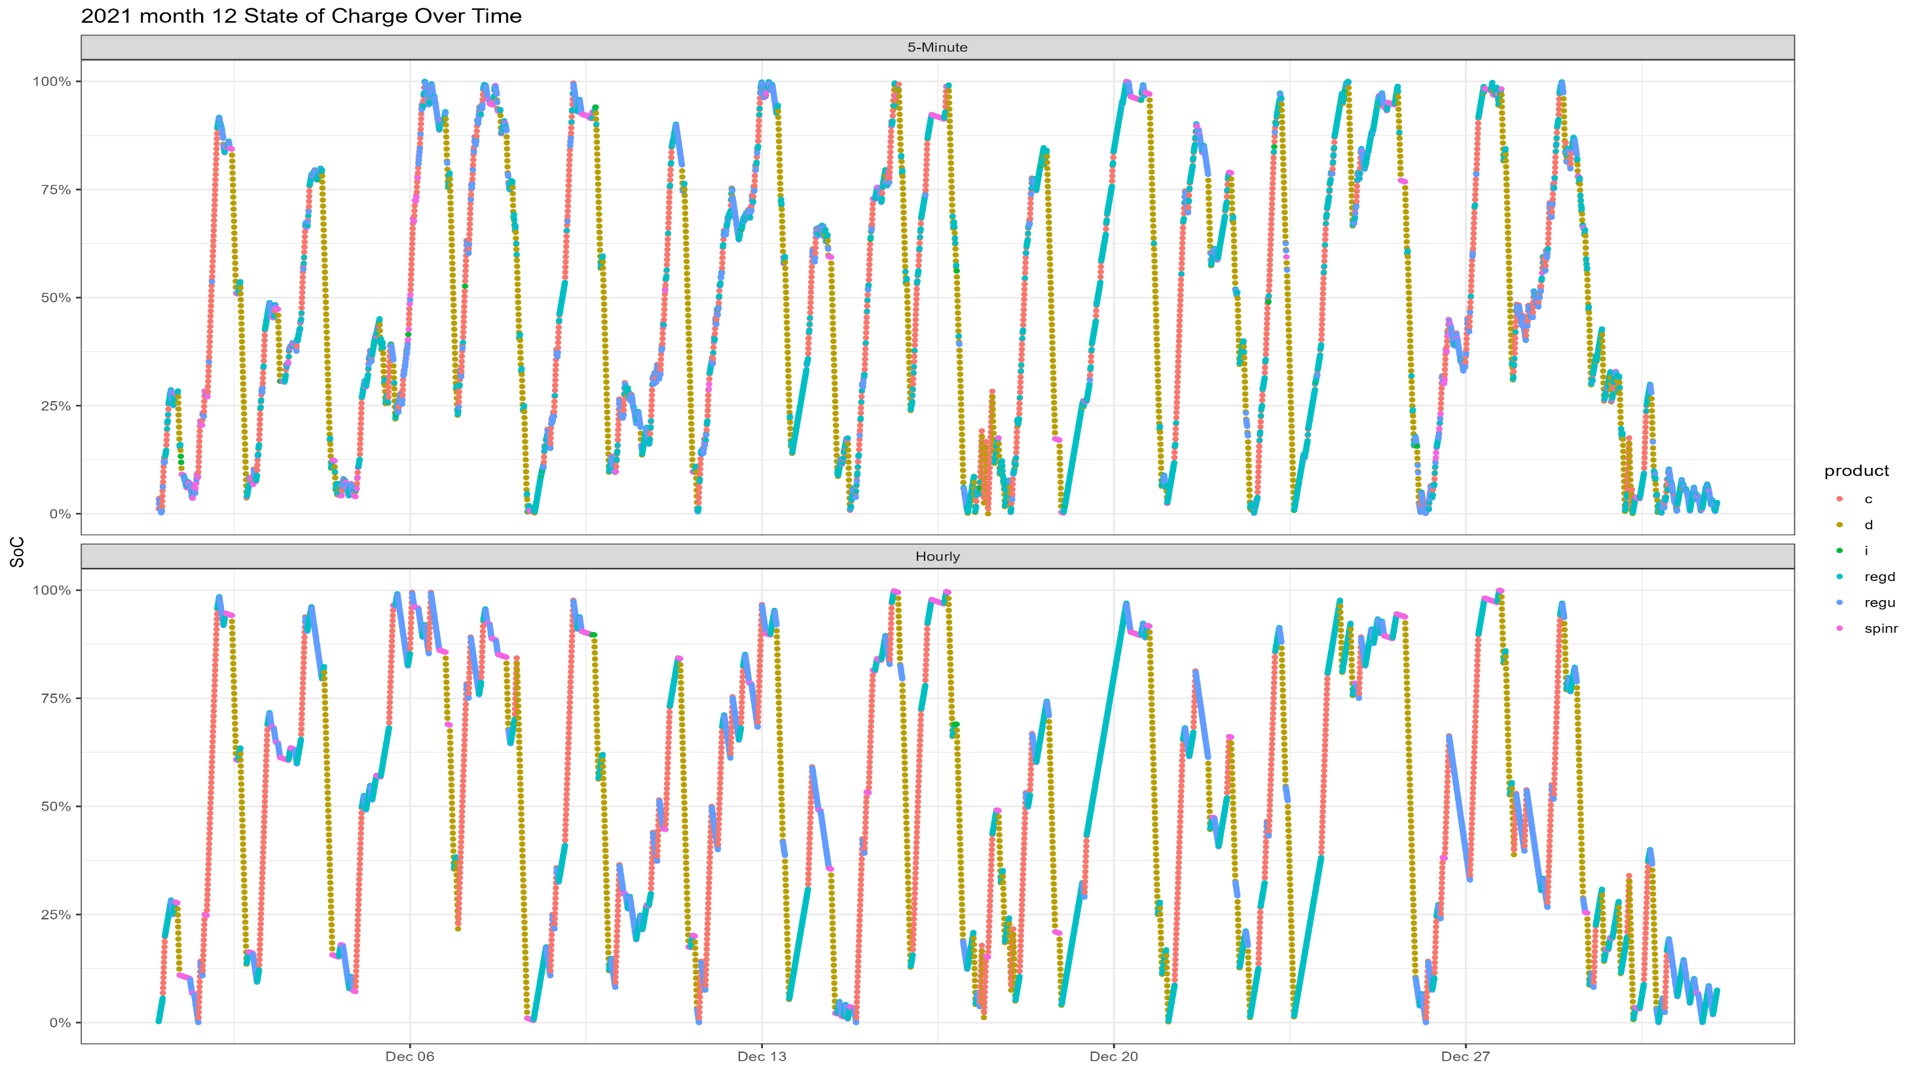

Slide 40
State of Charge Over Time
2022

Slide 41
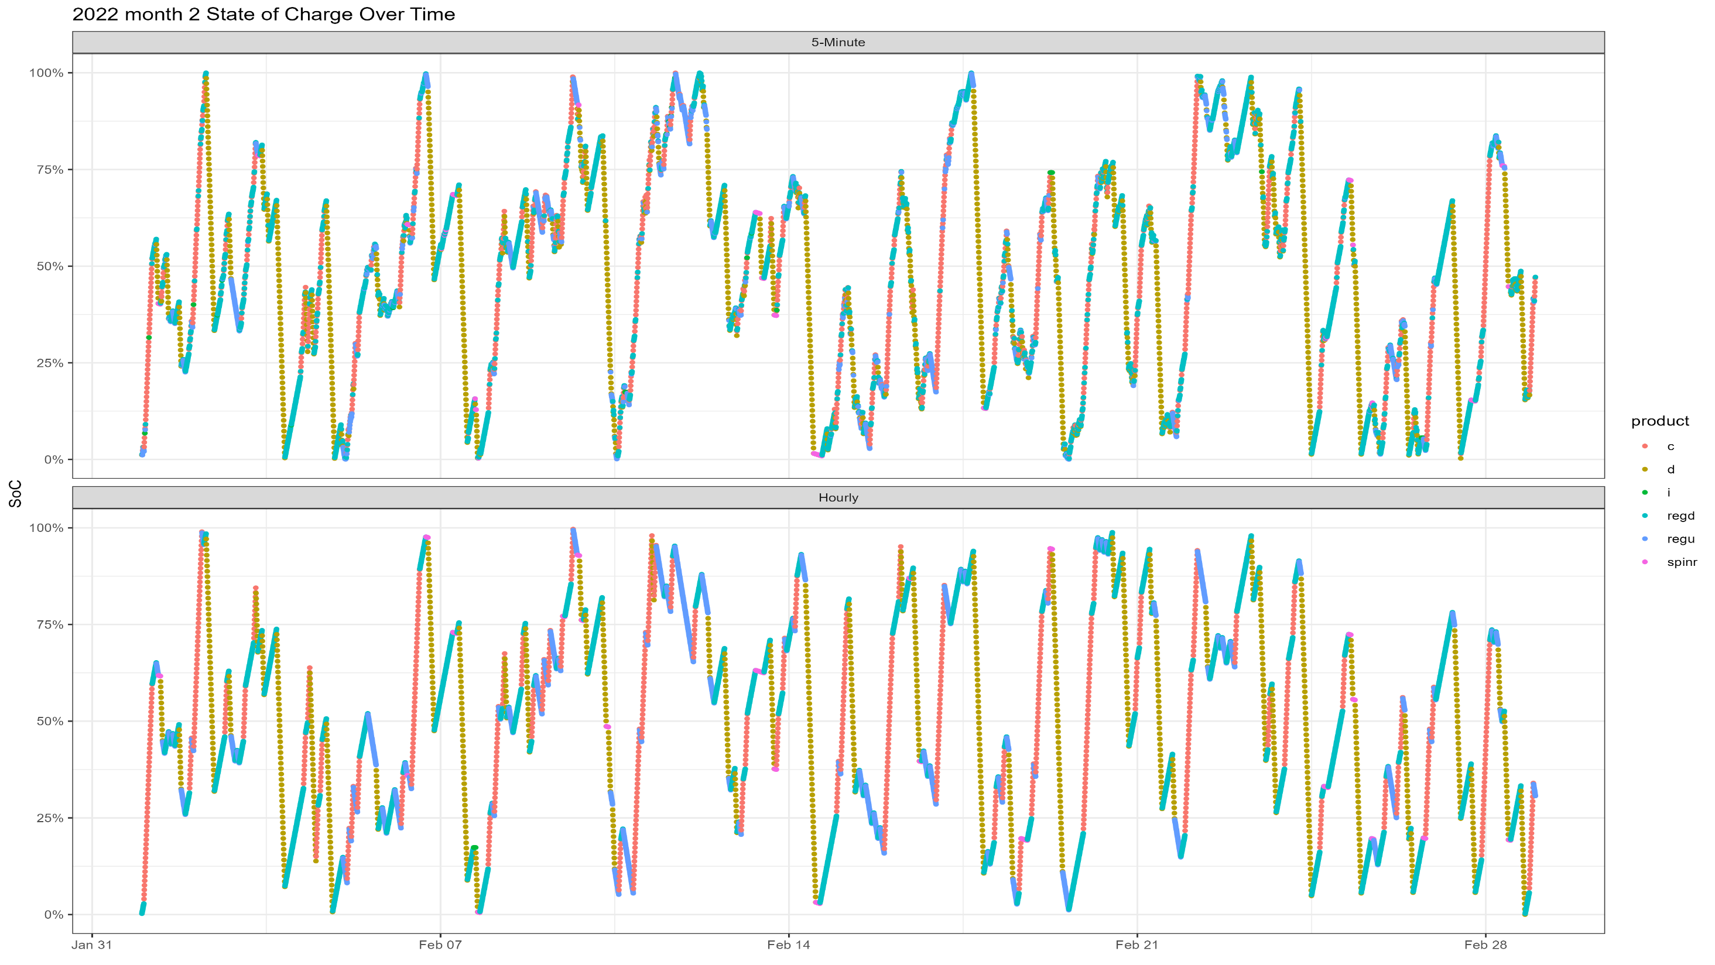

Slide 42
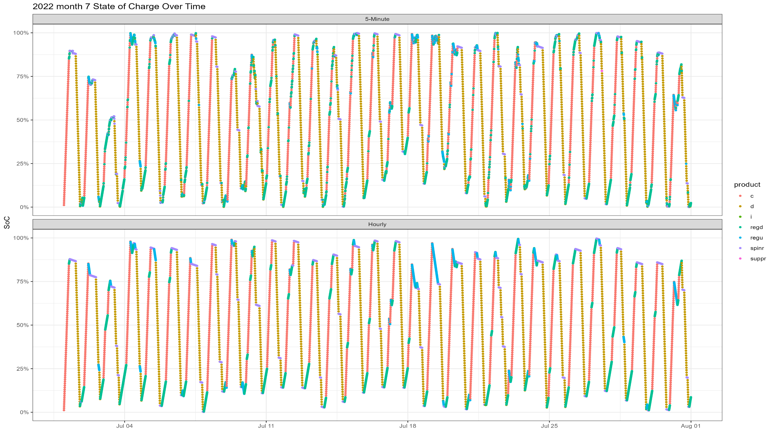

Slide 43
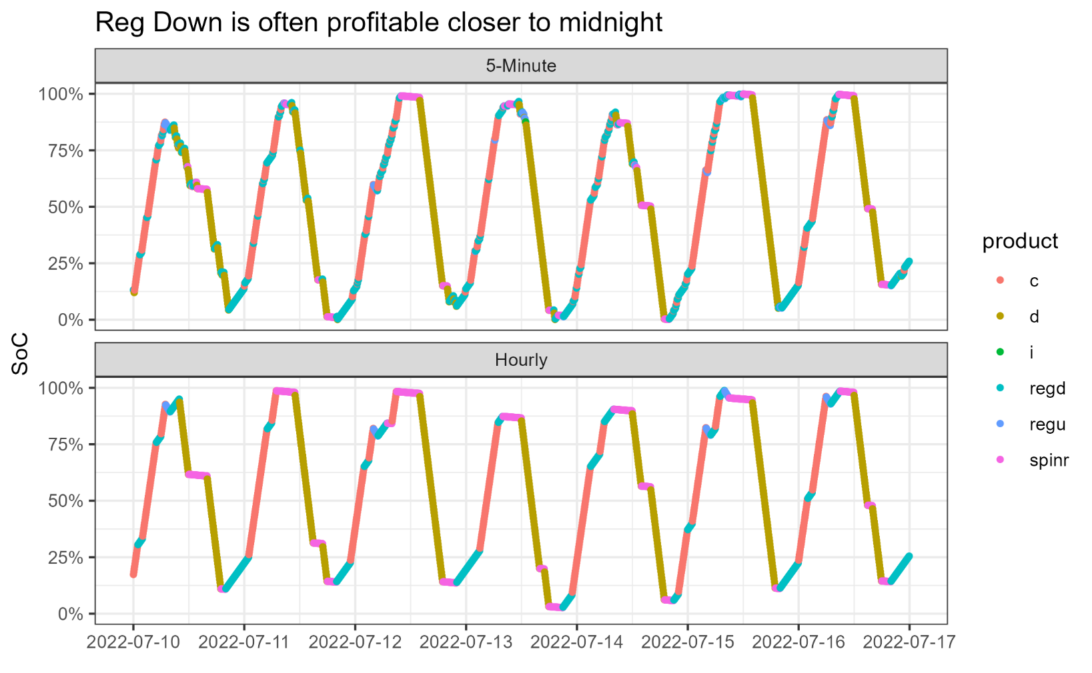
Weekly Highlight: 7/10-7/17
The model likes to start/end each day buying Reg down products
Note:reserve market participation at the peaks
Reserve markets have the lowest efficiency (about 1%), making it an effective alternative to idling

Slide 44
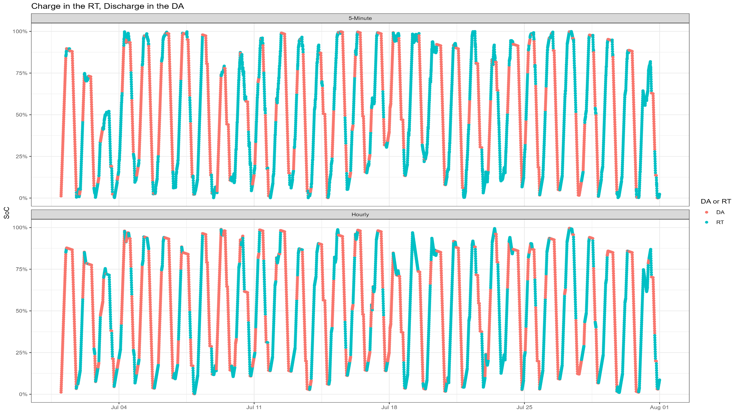

Slide 45
The battery will more often charge in RT and discharge in DA
5minute window
 | Discharge Product | Charge Product |  |  | Discharge Product | Charge Product
DA Product | 27432 | 5988 |  | DA Product | 56.5% | 10.7%
RT Product | 21109 | 49905 |  | RT Product | 43.5% | 89.3%
 | 48541 | 55893
Hourly window
 | Discharge Product | Charge Product |  |  | Discharge Product | Charge Product
DA Product | 32136 | 10356 |  | DA Product | 60.6% | 20.0%
RT Product | 20856 | 41532 |  | RT Product | 39.4% | 80.0%
 | 52992 | 51888

Slide 46
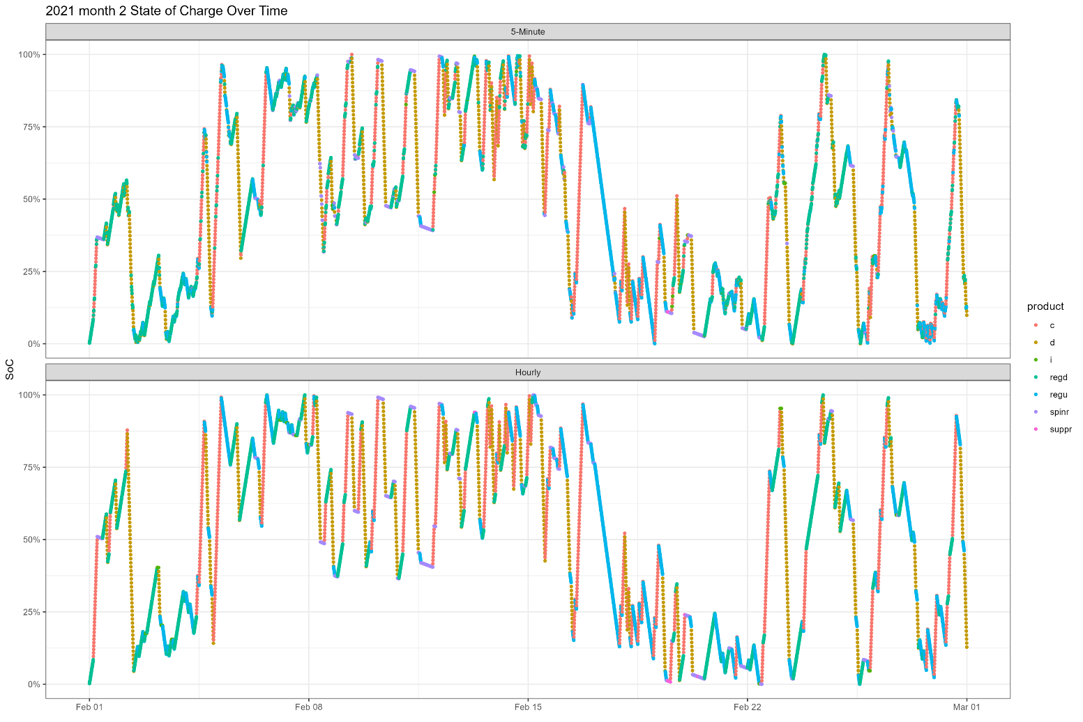
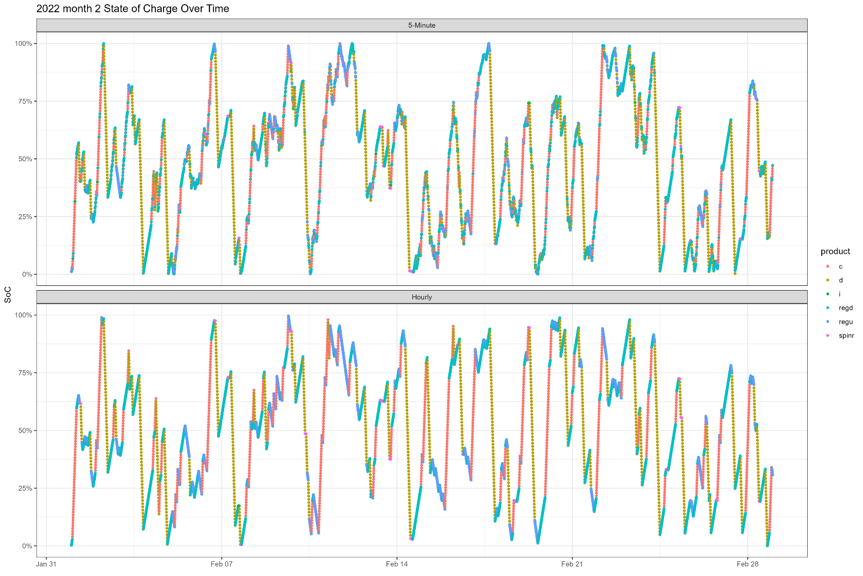

Slide 47

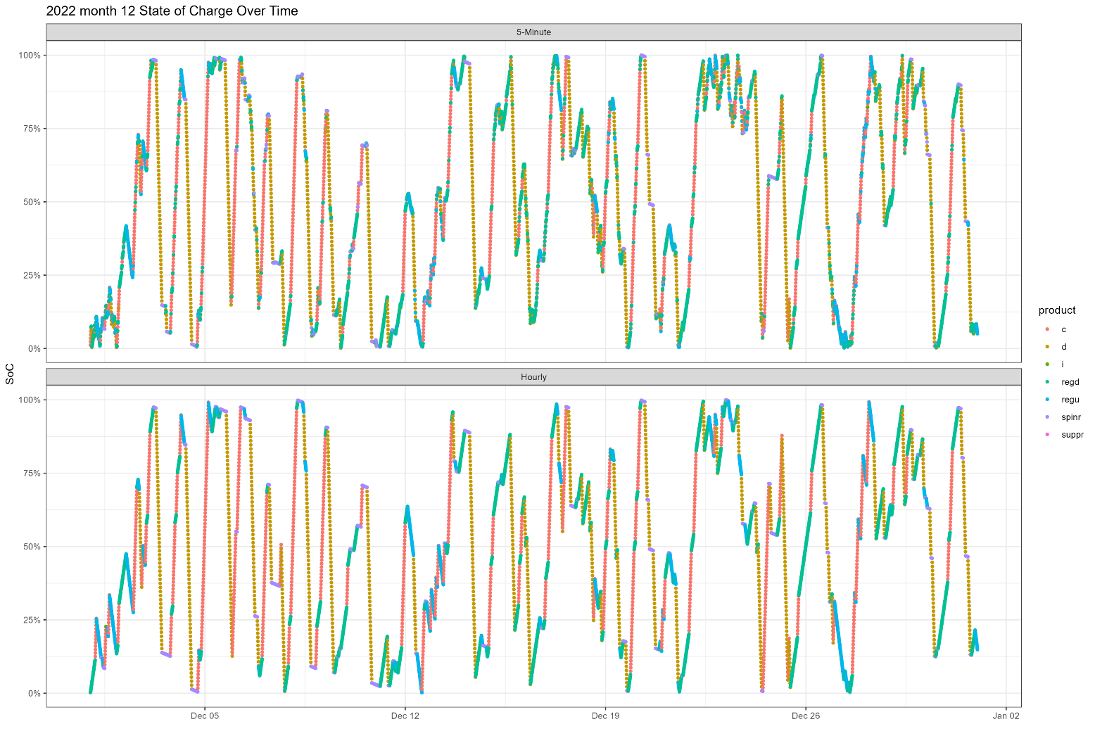

Slide 48
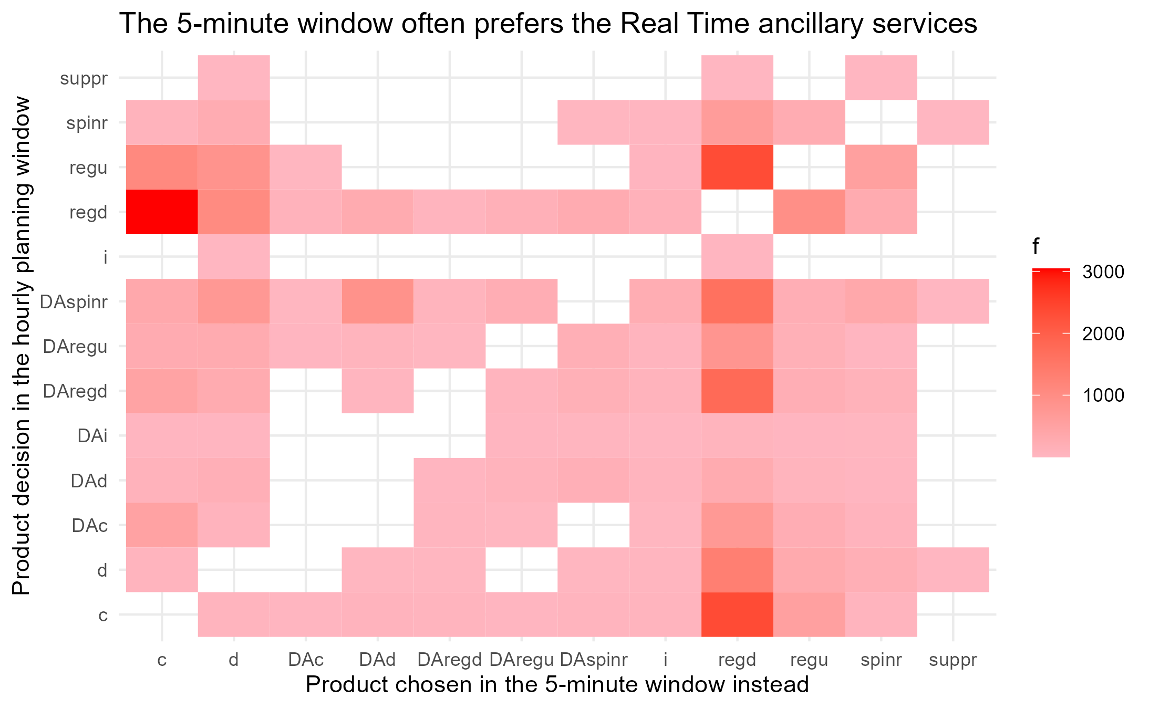
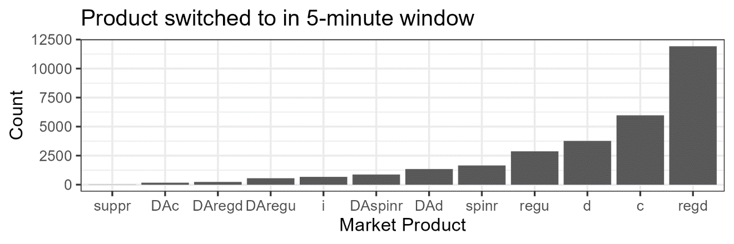
Key Decision points: When does the 5-minute planning window differ from an hourly?
Comparing each time interval..
Y – the decision made by the hourly window model
X – the decision made by the 5-minute window model
Color represents how often Y was chosen instead of X using the 5-minute planning window
In general, the 5-minute window tends to favor ancillary services, especially reg down

Slide 49
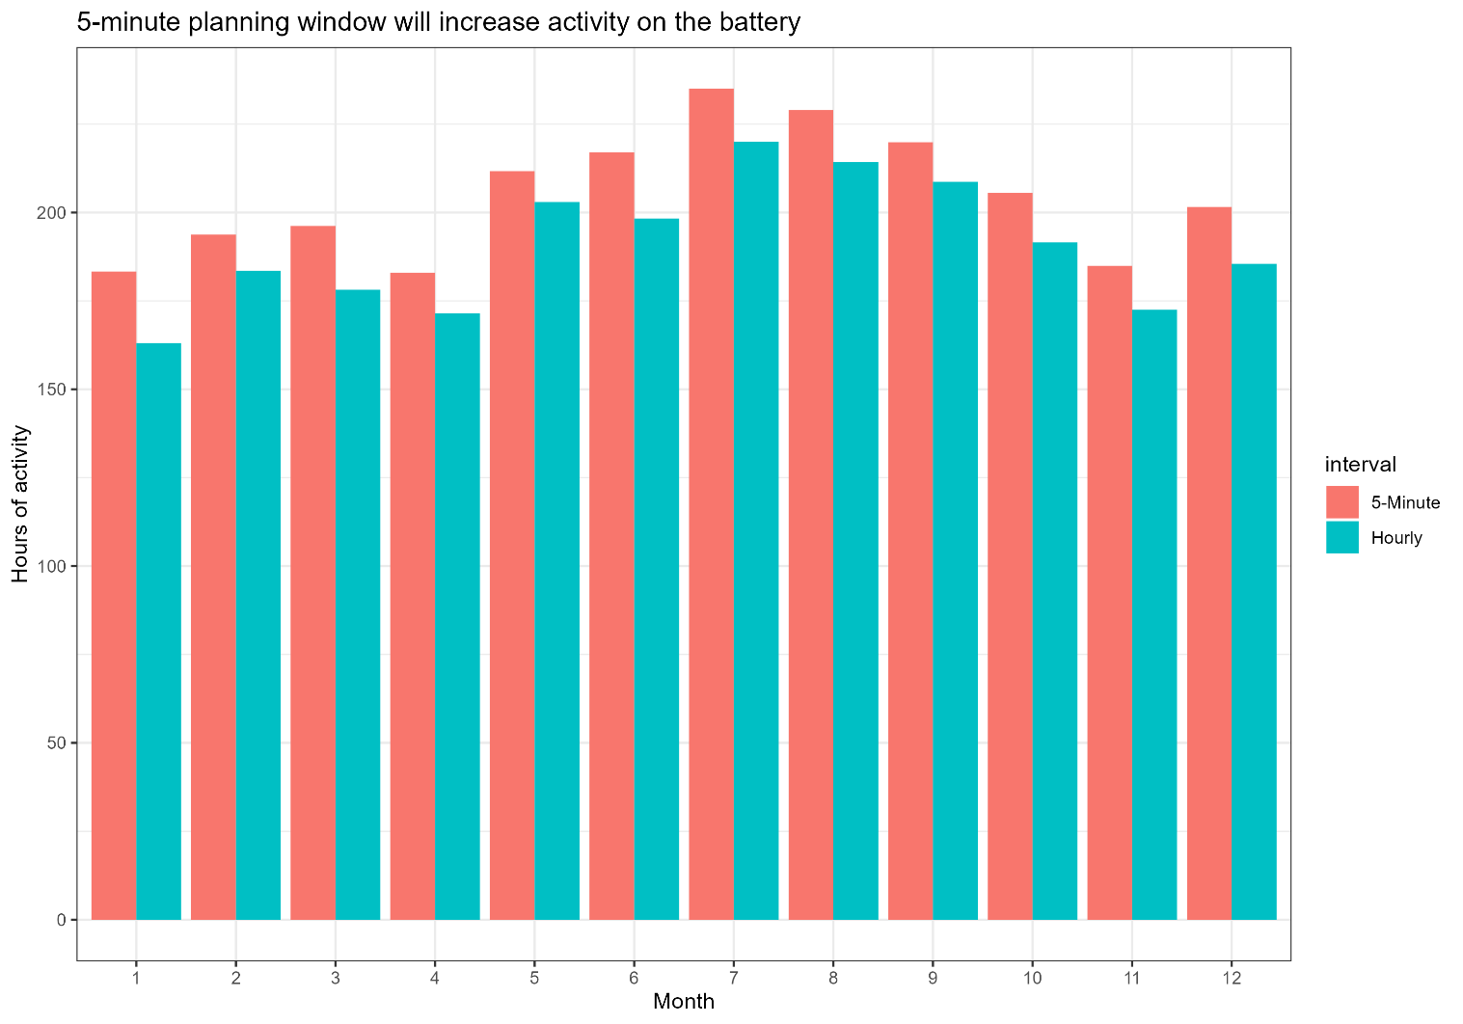
Mileage/Activity on the Battery
Values are |total change in energy| x duration of the battery
Month | 5-Minute | Hourly | % Increase
1 | 183.3 | 163.0 | 12.4%
2 | 193.7 | 183.5 | 5.6%
3 | 196.2 | 178.1 | 10.1%
4 | 183.0 | 171.5 | 6.7%
5 | 211.7 | 203.0 | 4.3%
6 | 217.0 | 198.3 | 9.5%
7 | 235.0 | 220.0 | 6.8%
8 | 229.0 | 214.3 | 6.8%
9 | 219.9 | 208.7 | 5.4%
10 | 205.5 | 191.5 | 7.3%
11 | 184.9 | 172.5 | 7.2%
12 | 201.6 | 185.5 | 8.7%

Slide 50
Take aways
The 5-minute planning window can take advantage of time periods with a lot of price variance more readily.
An asset will more often choose to charge when buying from the RT market, and discharge buying from the DA market.
The 5-minute planning window will tend to favor ancillary services when making a different decision.
Expected earnings on the battery are greater when using a 5-minute planning window.
Mileage on the battery will increase when using a 5-minute planning window

Slide 51
Future Research
Predictive forecast for market prices/bidding
Highlight how differently the planning windows optimize in uncertainty
Incorporate weather data and impact on earnings
Weather patterns alter market pricing, how does the asset respond when optimizing?
Sensitivity of the Model to Inputs
Min/max capacity, round trip efficiency, through put efficiency, etc.

Slide 52
Contact info and Links
Contact info: bschutte@unomaha.edu
External links
https://www.eia.gov/todayinenergy/detail.php?id=46756
https://www.spp.org/glossary
https://www.osti.gov/servlets/purl/1340043

Slide 53
Thank you!

